Slide 1


CAMPUS TO CORPORATE
ZAHEER NANJI
Notes:
Invitation note:
Campus to Corporate – An interactive 2-hour session to learn about the differences between the life on campus and the life in a corporate, as well as hear about what the industry is working on today.
The instructor is an industry professional with more than 20 years of work experience in designing and developing mission critical software applications for clients around the world.
To make the session interesting, the instructor will use tools and techniques so that students can engage and interact online.
For the best experience, students will be required to join a Zoom call using a PC or a laptop and also have a smart phone with them to answer questions and interact using online tools that help in making the session more engaging. Instructions will be provided at the beginning of the session.
Each student will be required to send 1 question BEFORE the session via email to the instructor. This question can be related to the software industry, technology, jobs or anything that the student would like to know from the Instructor. Of course, students can ask other questions during the session as well.
Only students who are really interested in interactive participation should attend. The general recommendation is to allow the 1st 15 interested students only. Subsequent batches may be arranged if more students are interested.

Slide 2


Disclaimer
The views, opinions and concepts described and/or discussed during this session are based on the experience of the speaker alone and may not necessarily reflect the thought of the industry as a whole or that of other individuals.

Slide 3
CAMPUS TO CORPORATE - AGENDA
About myself
Objective of this session
Gaps between campus and corporate
What the IT industry does
How the IT industry has changed
How the change has impacted software engineers
Expectations from you
What is the industry doing today?
Your Questions

Slide 4
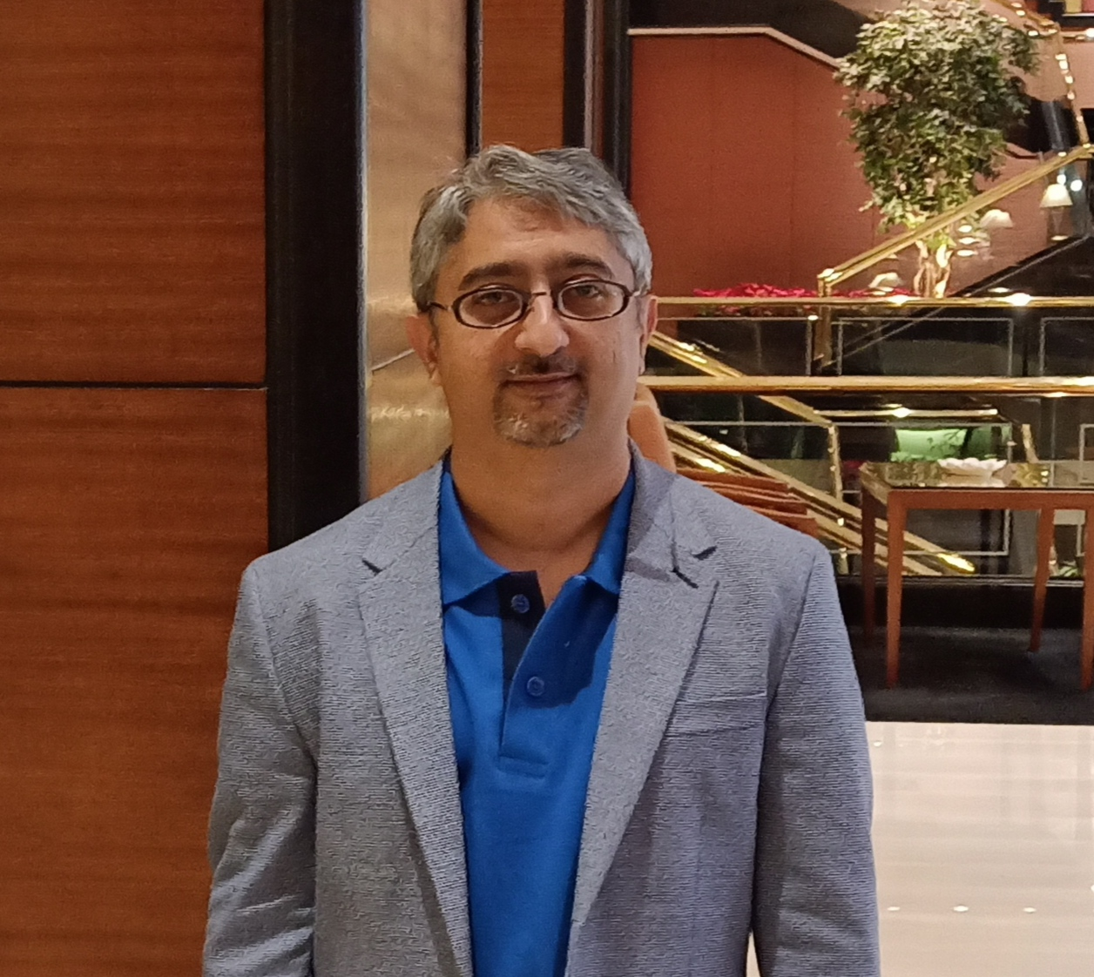
Zaheer Nanji
20 Years of experience in Application development & Digital Technologies
Working at NTT Data Corporation, Tokyo, Japan.
Worked with clients globally in Europe, Asia, North America
Leading a team of Technical Architects in Digital areas such as Cloud, Blockchain, Containerization and Application development.

Slide 5
Let’s keep the session interactive !!

Slide 6
Why this Session?
Notes:
We all know there is a gap between what we learn in college and what is required by the industry.
Let me hear from you..what differences do you think you will see between the 2? Please use the raise hand button and I will unmute you.
This session is to have an interactive discussion so that you understand some of the changes you will see in the corporate world and what the industry expects from you as software engineers.
Question: How many of you think there is a gap between what is taught on campus and what exists in the corporate environment?
Option 1: There is a small gap
Option 2 : There is a huge gap
Option 3 : There is no gap

Slide 7
Is there a GAP between campus and corporate ?

Slide 8
Why is there a gap?

Slide 9
How can the gap be reduced ?

Slide 10

What does your curriculum cover?

Slide 11
What does your curriculum cover?

Slide 12
What does it not cover?

Slide 13
Responsibility – Its not college any more !!
Continuous learning “It is important to remember that one should educate—for a life time of further learning—not train for specific tasks”
Deadlines
Changing Requirements
Scalable and secure applications
Frameworks and libraries
Existing “Bad” Code
Inter Team Interactions
What does it not cover?

Slide 14

What do we do in an it company?

Slide 15

Journey of the Indian it industry
Repetitive programming
Application maintenance
Infrastructure monitoring
Product Development
RnD
Innovation and Design

Slide 16
How has the change impacted software engineers?
We all need to work harder and continuously keep learning
Stop expecting that the company will teach you everything
Those who stop learning, stop earning

Slide 17
Expectations from a software engineer
Troubleshooting
Ownership and Leadership
Inclination towards continuous learning and experimenting
Edge over standard market material
Knowledge of newer technologies and their applications
Communication and Presentation
Understands the big picture
Team player
Self motivated
Even insane looking problems are sometimes real

Slide 18
What Is the industry doing today?
The industry is in a phase called digital transformation

Slide 19
Digital transformation
Digital transformation is changing the way business gets done and, in some cases, creating entirely new classes of businesses.
Uber, Netflix, Amazon

Slide 20
DATA IS THE NEW GOLD
Software Applications have been generating data
Type of data
Data to Information
Information to business
DATA ANALYTICS AND DATA SCIENCE IS “in”

Slide 21

Why is it so “cloud”y?

Slide 22
What is the cloud?

Slide 23

Answers to your Questions
Notes:
How many from a non-programming background?

Slide 24
What kind of topics would you be interested in for future sessions
Notes:
How many from a non-programming background?

